Slide 1
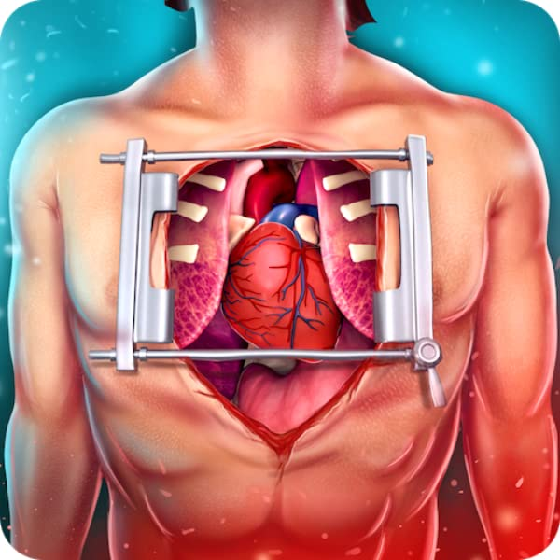
Preparing for Urgent, Emergent, and Emergency Open-Heart Surgery.
Name:
Course Title:
Thursday, 10 December 2020
Instructor:

Slide 2
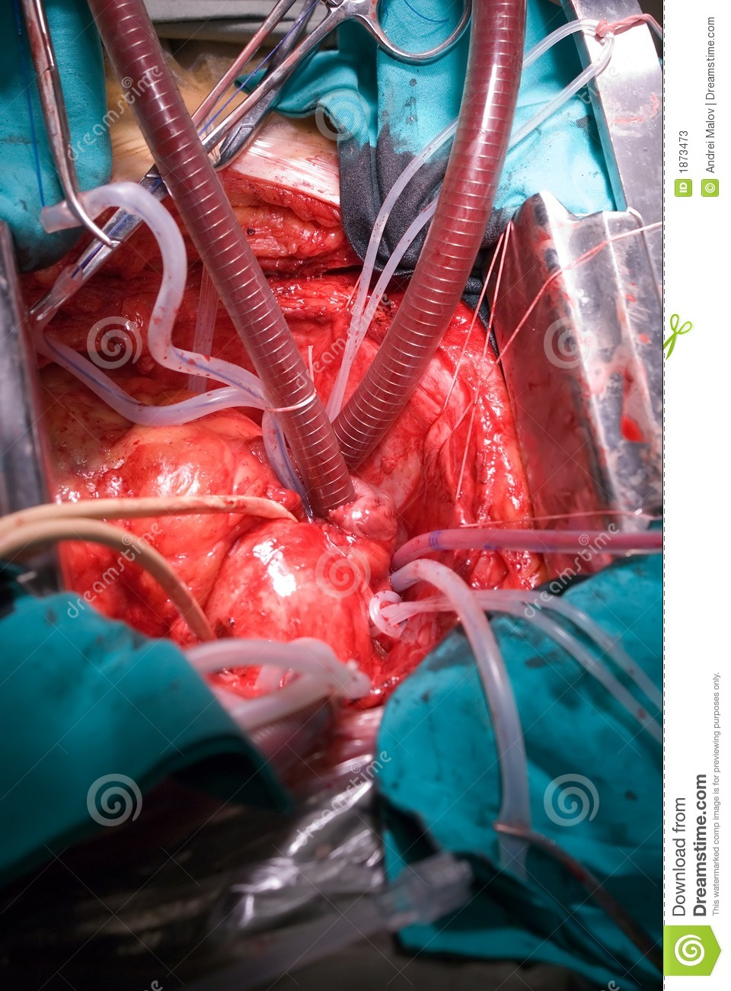
Introduction
Khan, Hameedullah, Irfan, Tariq, and Fatimi, (2017) discusses estimate that about 0.2 percent of all tumors that are recorded worldwide are related to the heart.
One of this tumors is the Primary Cardiac Tumor which rarely occur with lowest estimates being 0.0017% while the highest is 0.19%.
Cardiac Myxomas is the most common heart tumor that requires operation to remove.

Slide 3
Symptoms of Atrial Myxomas
Patients suffering from Atrial Myxomas exhibits the following signs and symptom
    Dyspnea as well as syncope
    Fever and other constitutional symptoms
    Anorexia
    Thromboembolic event
    Shortness of breath
To confirm that there is a tumor in the heart, an angiography examination is need

Slide 4
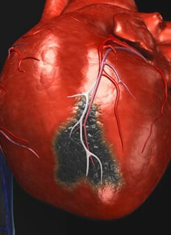
Case Study: Tests
Khan, Hameedullah, Irfan, Tariq, and Fatimi, (2017) used a case study of a 50 years old woman who experienced short breath.
She had undergone numerous chest tests but the underplaying condition was not identified.
She was referred to emergency unit after developing serious health problems
Examination to establish her condition showed that all was normal until when angiography which revealed a descending artery stenosis.
Echocardiogram test showed that she had a large left atrial myxoma.
The condition was causing severe mitral regurgitation

Slide 5
Case Study: Tests
Apart from heavy chest and shortness of breath, the patient did not exhibit any other symptom associated with cardiac growth
  No neurological symptoms
  No constitutional symptoms
  There were no any significant body weight loss
  She had no any serous health problems apart from well managed hyperlipidemia and hypertension.
  She had a clear chest auscultation
  She also had a normal heart sound
  Her routine clinical examination showed that she was having no health complication

Slide 6
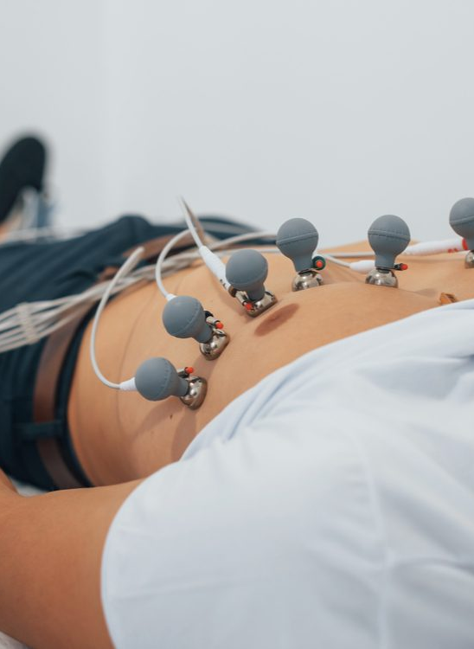
Case Study: Tests
The following test revealed her condition
  Angiography
    Showed the tight left anterior descending artery stenosis
  Thoracic radiogram
    Normal results
  Echocardogram
    Showed enlarged left atrial myxoma
    Half of it protruded through mitra valve into left ventricle
    This caused serous regurgitation
    Left ventricle not dilated
    It helped to note that there was an paltry pericardial effusion round the heart.

Slide 7
Case Study: Treatment
Khan, Hameedullah, Irfan, Tariq, and Fatimi, (2017) note that an operation had to be performed immediately to remove the tumor and restore a normal flow of blood.
An open heart surgery was performed
Doctors were able to identify the myxoma and expunged it.
The patient was placed under cardiopulmonary bypass
Left atrium was operated by opening the using an approach called superior septal

Slide 8
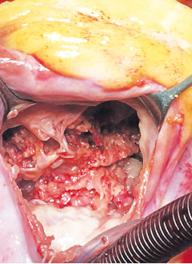
Case Study: Treatment
The identified atrial myxoma had the following characteristics
  Soft
  Very friable
  Arisen from anterolateral potion of mitral valve
When the base was identified, the growth was surgically removed
This resolved the mitral annulus
Normal flow of blood was restored.

Slide 9
Case Study: Follow Up
The patient was followed for two months
She underwent regular checkups to identify any complication
The patient recovered normally with no complication.

Slide 10
Case Study: Follow Up
From the followup of the patient, Khan, Hameedullah, Irfan, Tariq, and Fatimi, (2017) recommends that patients should undergo echocardiography to detect the heart problem as early as possible
This will hasten the treatment procedure and avoid complication.

Slide 11
Recurrence
Myxomas especially the left atria shows excellent healing process.
Most of these surgically removed tumor never recur.
Only about three percent will recur after being removed.

Slide 12
Recurrence
When the tumor recur, it should be diagnosed and treated as soon as possible.
When interventional measures are not taken, serious complications can arise such as
  Fatal thromboembolic event
  Mitral stenosis symptoms
  Collagen vascular disease
  Infective endocarditis
  Other complication
  Death
Timely and effective treatment is thus essential in determining the success of the healing process.

Slide 13
Conclusion
Proper preparation is essential for a successful, Urgent, Emergent, and Emergency Open-Heart Surgery
All stakeholders should effectively play their roles in a timely manner to avoid complication
The patient should go to hospital once he feels unwell
The doctor should also conduct several test until the condition is identified

Slide 14
Conclusion
A follow-up is important to ensure that the patient recover faster
It will also minimize the chances of complication
When the complications do occur, they can be managed immediately to avoid fatal eventualities.

Slide 15

Thank You

Slide 16

References
.
Khan, H. A. R., Hameedullah, A., Irfan, O., Tariq, M., & Fatimi, S. H. (2017). Mitral annulus myxoma extending into left atrium and left ventricle with severe mitral regurgitation as a pre-operative finding, a rarity. International Cardiovascular Research Journal, 11(2), 84. https://www.sid.ir/FileServer/JE/130620170208.pdf

